Slide 1
UI/UX Case study-Mobile Banking Redesign
Day 2-User Research and Analysis

Slide 2
The survey Questions
How old are they?
How often do they use the banking application they use?
For what purpose do you use the application most?
A) Payment
B)Money transfer
C)Card information
D)QR
E)Others

Slide 3
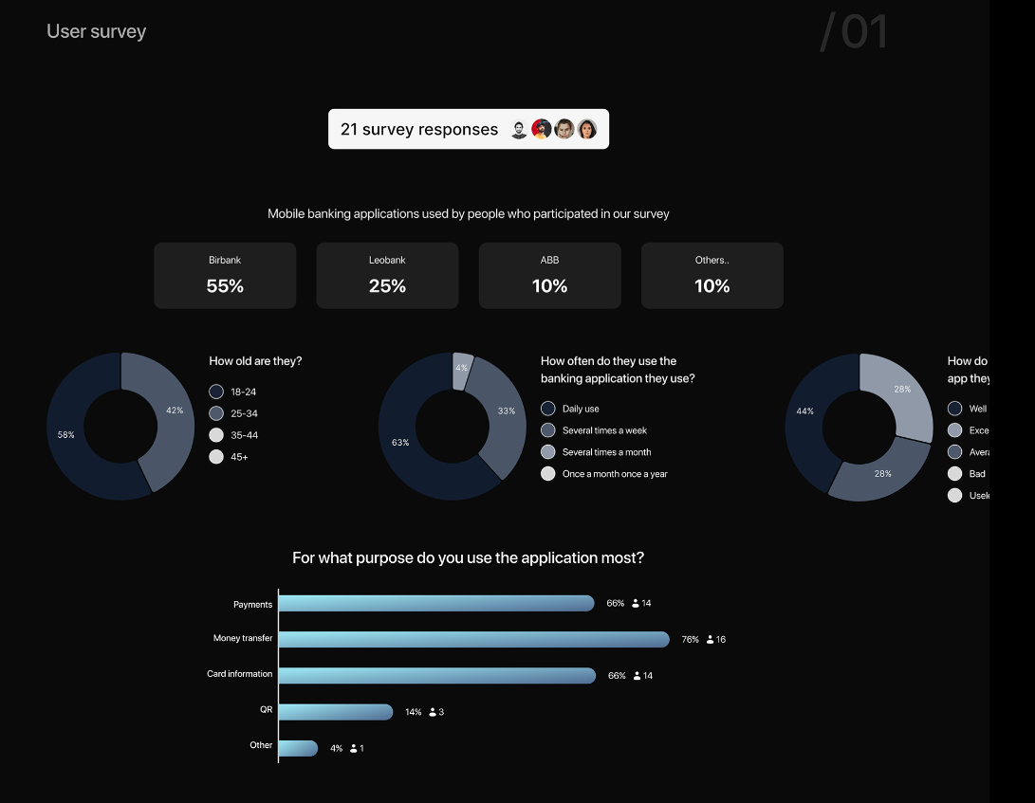
Survey Report

Slide 4
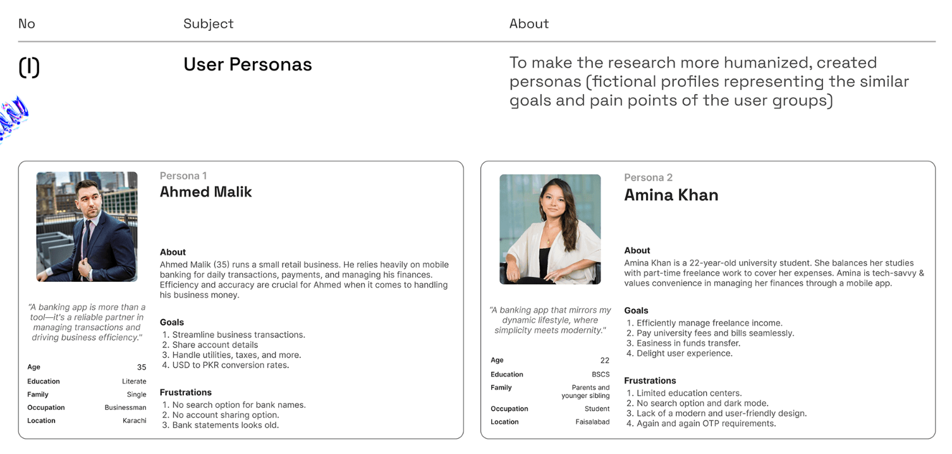
User Personas

Slide 5
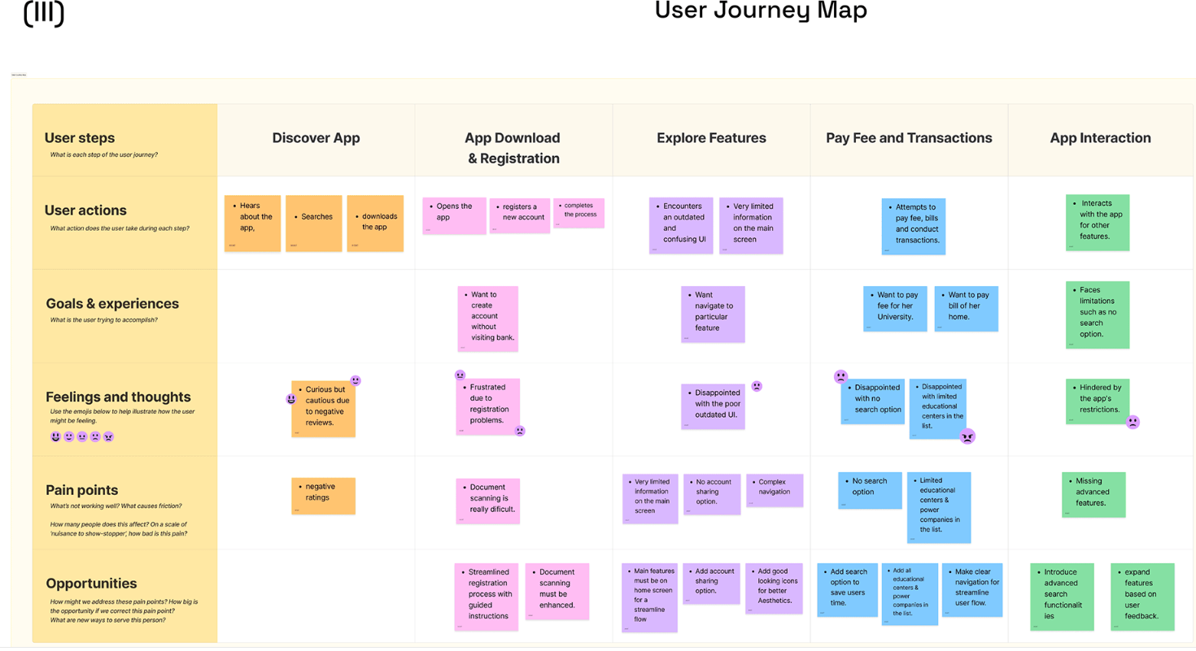
User Journey Map

Slide 6
Conclusion
By the end of Day 2,I have conducted detailed user research, created user personas and journey maps, and documented all findings.
Take the Survey questions to the users, and submit the survey report here.

